Slide 1

Analysis of The Used Car Market Trends
on
CARZ 4 SALE
By :- Rajeshwar Jadhav

Slide 2


Business Problems:
The used car market in India is highly fragmented, The people buying or selling used cars often don’t know the right prices of the cars.
The prices can be changed depending on the car brands, age, fuel type, how many people owned it before, and where it’s being sold.
This makes it hard for buyers to get a fair deal and for sellers to price their cars correctly.
Objectives of the project:
The primary objectives of this project is to analyze the used car market on Carz 4 Sale.com by exploring the data-driven insights that can help optimize pricing, forecast demand, and improve the overall customer experience.
The goal of this analysis is to understand what affects the price of used cars—like brand, year, fuel type, and ownership.
We also want to compare prices across the cities, find popular car models, and see how fuel type and ownership history impact resale value.

Slide 3
Web Scraping:
Web scraping is a way to automatically collect the data from websites. By the help of the Requests and the Beautiful Soup.
Instead of copying the information by hand, you use code (often in Python) to grab the data like prices, product details, or reviews from the web pages.
The scraper sends a request to the website, reads the HTML content, and pulls out the parts you need—then saves it in a clean format like a spreadsheet or in the form of the Data Frame.
It’s useful for the market trends or research, price tracking, lead generation, and many more.

Slide 4
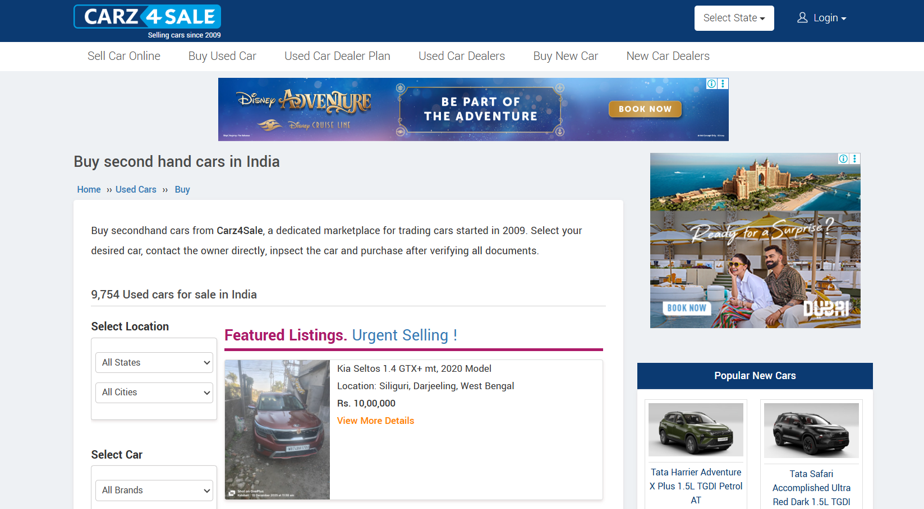
Interface of the website:

Slide 5
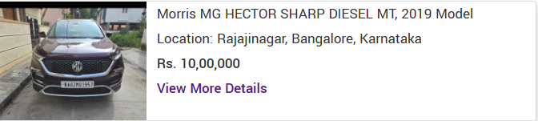
Extracting the Data From the Containers:
Extracted the details from the container like car name, fuel type,
car year, car price, car location like car state and car city.

Slide 6
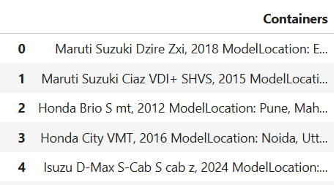
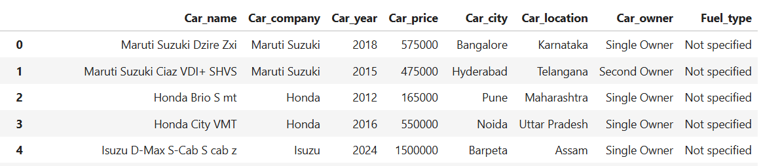
Data Cleaning:
The original data frame was not cleaned, so I performed several data cleaning operations on it.
This included removing unnecessary columns and characters, handling missing values, and converting columns to appropriate data types to ensure the consistency.
OLD
NEW

Slide 7
Data Visualization:
The Data Visualization is the art of turning the raw data into visual formats—like the charts and the graphs—to make the patterns, trends, and insights easier to understand and communicate that’s why we use the visualizations.
There are 3 types of Data Visualization techniques that are :-
Univariate Analysis.
Bivariate Analysis.
Multivariate Analysis.

Slide 8
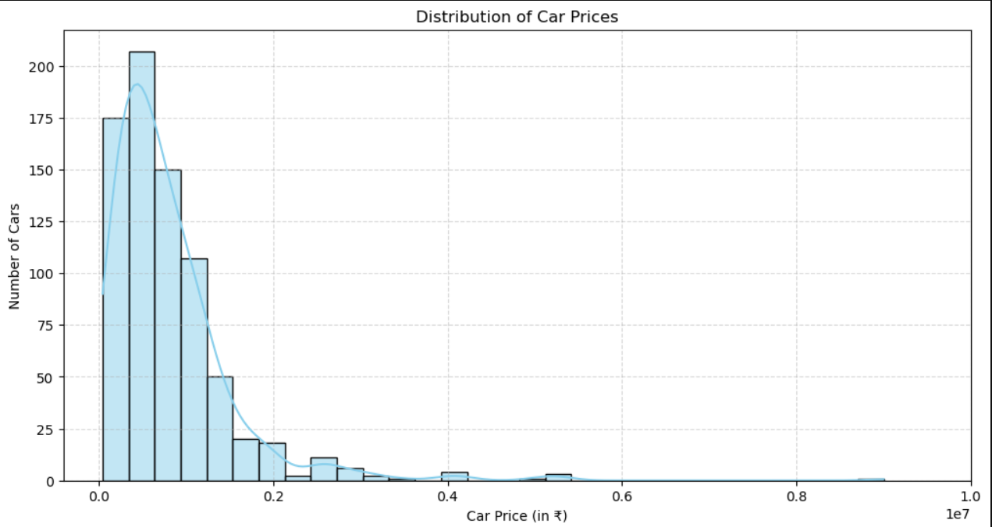
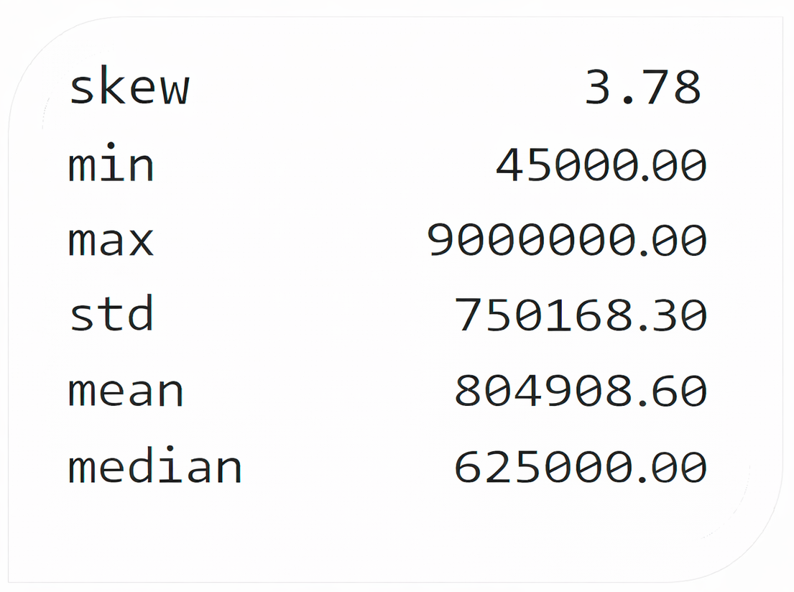
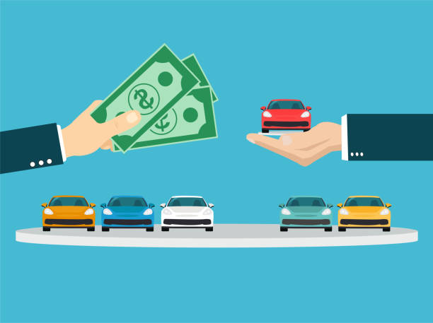
Numerical Column
Univariate Analysis
The price ranges of cars which are having the highest demand.
Most cars are priced on the lower side, but a few very expensive ones push the average up.
The chart shows a lot of cheaper cars and just a few luxury ones. So, car prices are mostly affordable, with some high-end exceptions.

Slide 9
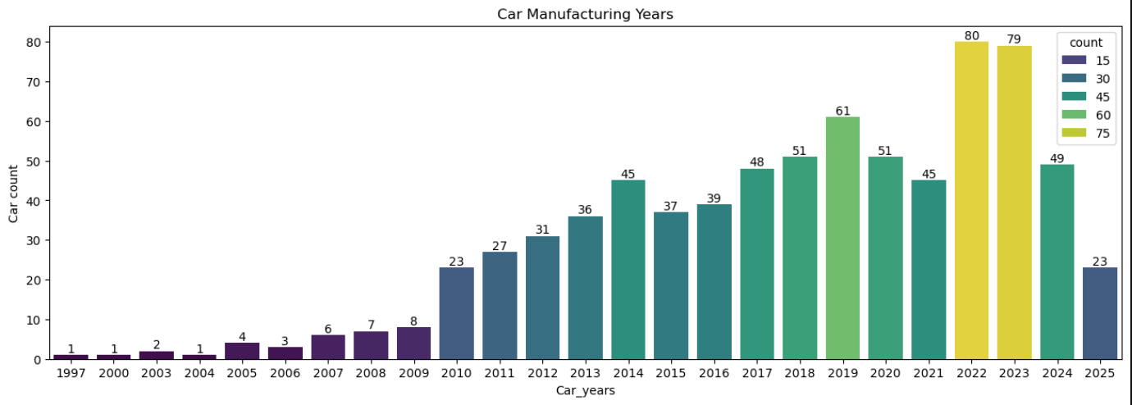
In which year the highest number of cars was manufactured.
It shows that the highest number of cars was manufactured in the year of 2023.
And it also shows that the highest number of cars was manufactured from the year of 2010 to 2024.

Slide 10
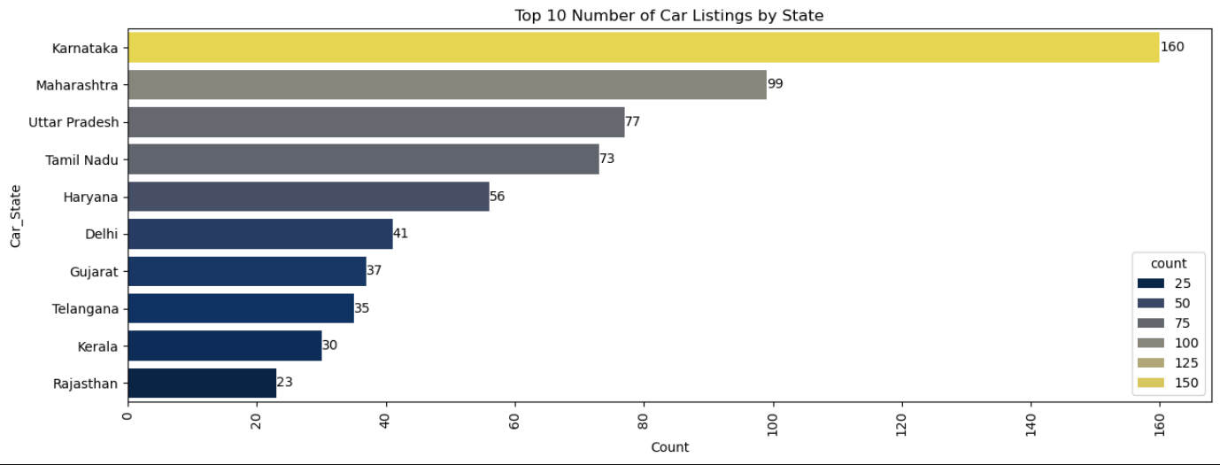
Categorical
Column
Top 10 States which are having the highest number of cars for listings for sale.
The States like Karnataka, Maharashtra, Uttar Pradesh are having the highest number of cars for listings for sale.
The States like Rajasthan, Kerala an are having the least number of cars for listings for sale.

Slide 11
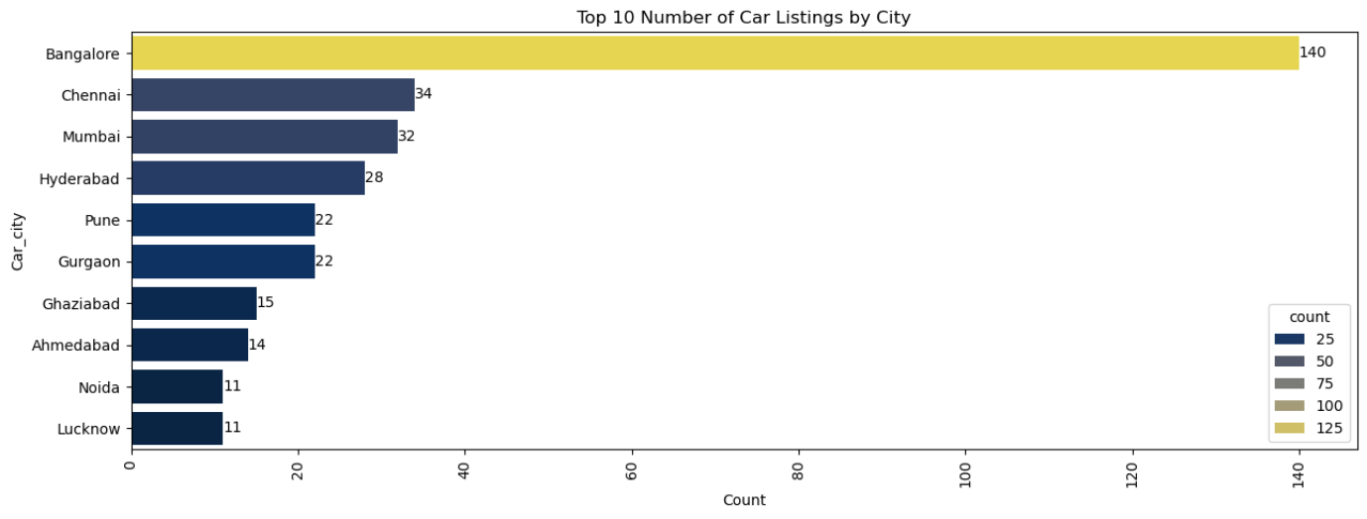
Top 10 Cities which are having the highest number of cars for listings for sale.
Cities like the Banglore, Chennai and Mumbai are having the highest numbers of cars for listings for sale.
Cities like Lucknow and Noida are having the very least numbers of cars for listings for sale.

Slide 12
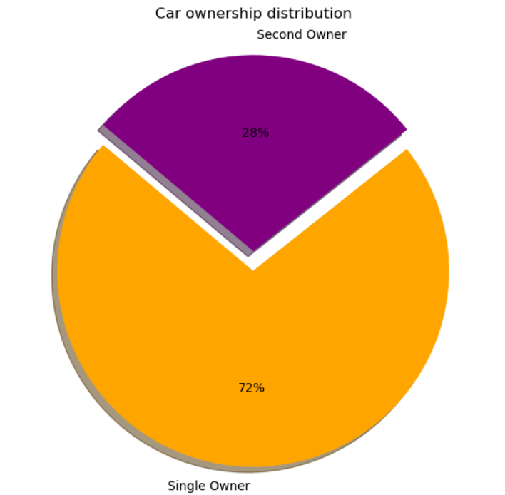
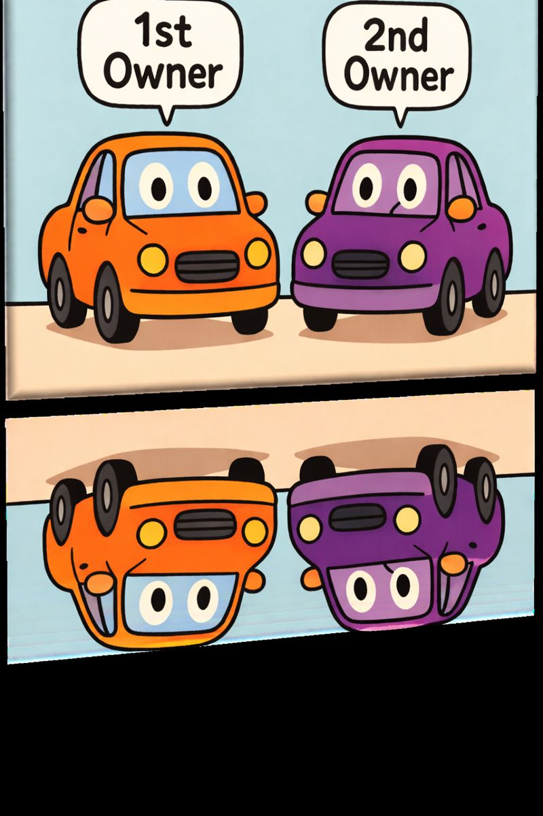
The distribution of ownership types—are most cars single-owner or second-owner.
The distribution of the Car Ownership is of two types that are of Single-Owner and the Second-Owner.
The most cars are the single owner that is 72% cars are Single-Owner.
The least cars are the second owner that is 28% cars are Second-Owner.

Slide 13

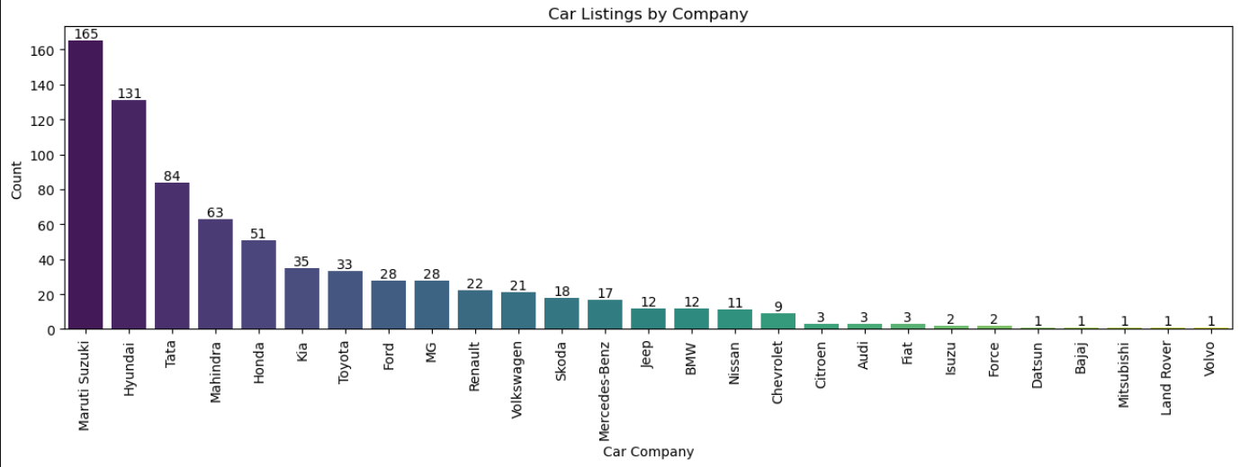
Which car company is having the most listings in the dataset.
The Company like Maruti Suzuki, Hyundai and Tata dominate the dataset indicating the strong market presence or popularity in the listings.
The Company like Mitsubhishi, Land Rover and Volvo are less frequently in
the listings.

Slide 14
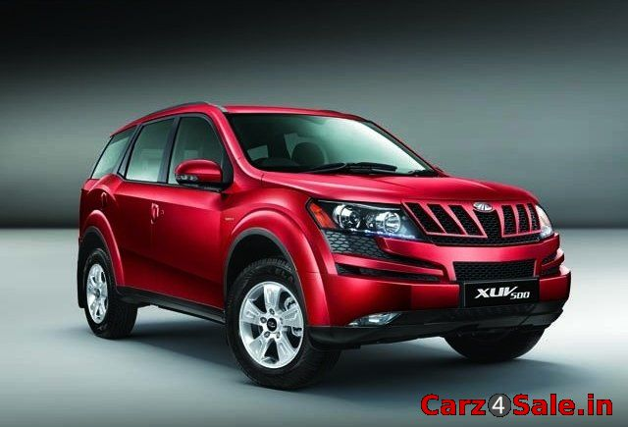
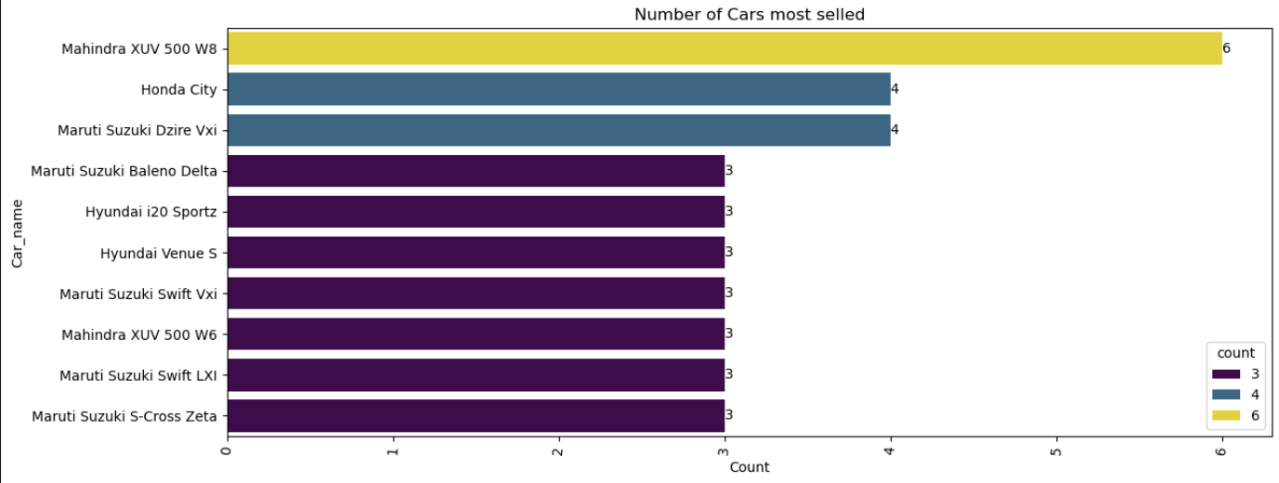
Top 10 most selled cars.
From the top 10 Cars the Car Mahindra XUV 500 W8
is the most selled car as the top 10 cars.
XUV 500

Slide 15
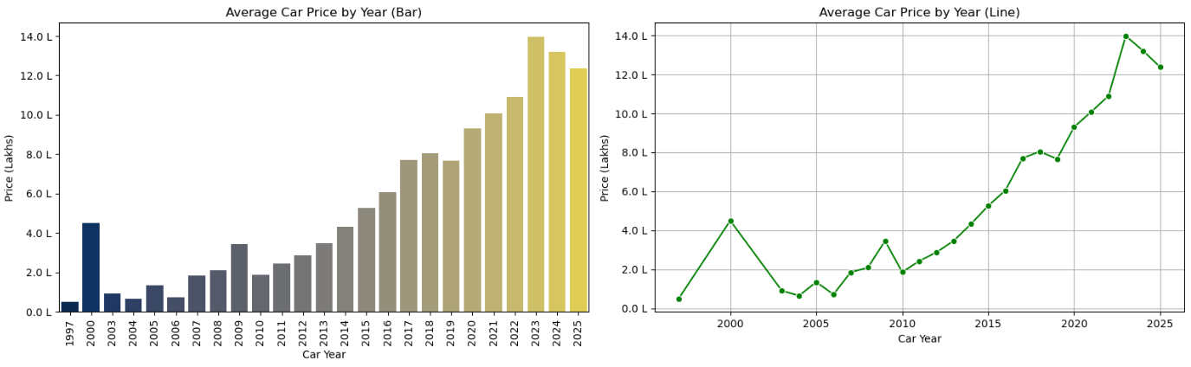
Numerical
vs
Numerical
Bivariate Analysis
How does the price of cars vary across different manufacturing years.
Together, both plots highlight that car prices have been rising year by year, likely due to factors like inflation, advanced features, and increased demand for newer models.
However, certain years may show price spikes due to luxury or high-performance listings.

Slide 16
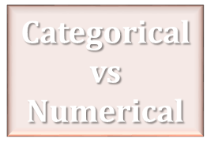

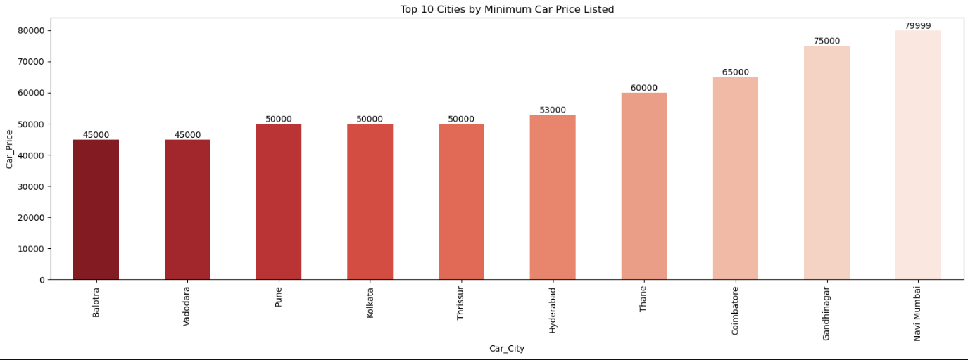
Top 10 Cities Which are having the minimum car price for sell.
The top 10 cities which are having the minimum car price for sell are the Balotra, Vadodara, Pune and etc.
The minimum car price for sale and from the top 10 cities is the Balotra and Vadodara is around 45000 Thousand.

Slide 17

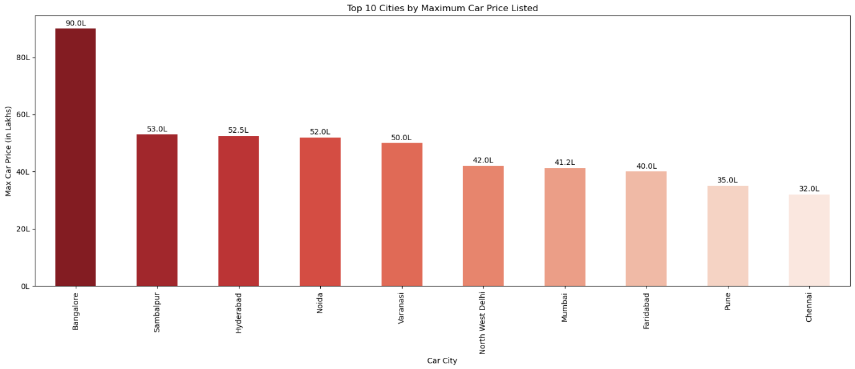
Top 10 Cities Which are having the maximum car price for sell.
The top 10 cities which are having the highest car price for sell are the Banglore, Sambalpur, Hyderabad and etc.
The maximum car price for sale and from the top 10 cities is the Banglore and it is around 9000000 Lakh.

Slide 18

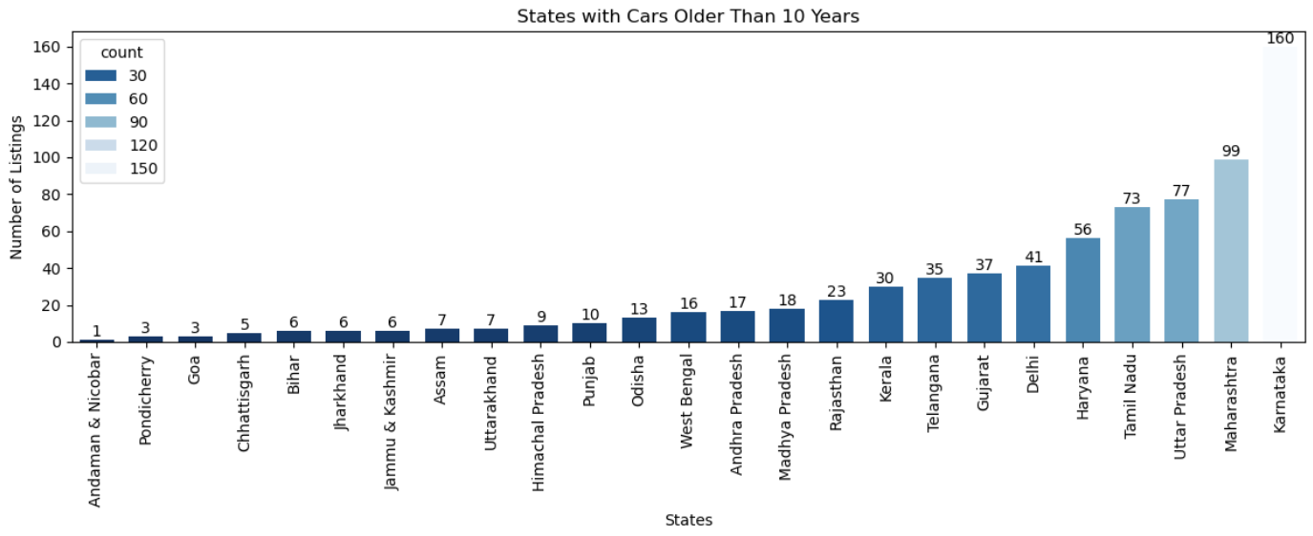
OLD
The States with the most listings for cars older than 10 years.
The States like the Karnataka, Maharashtra, Uttar-Pradesh, Tamil-Nadu
and etc are tends to have the more listings for the older vehicles.

Slide 19
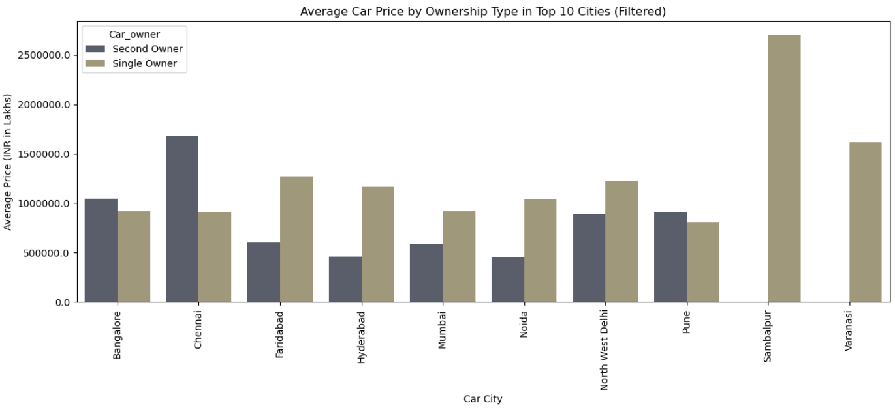
How does ownership type affect car price in top 10 cities.
In the top 10 cities, cars with single owners are usually having higher price than those with second owners.
In Chennai, second-owner cars cost more than single-owner cars, likely because expensive or luxury used cars are in higher demand there.

Slide 20
Conclusion
The Carz4 dataset reveals that car prices are influenced by ownership type, city, brand, and age. First-owner vehicles consistently fetch higher prices, showing buyer preference for less-used cars.
Cities like Mumbai and Banglore lead with premium pricing, while others like Balotra and Vadodara offer more budget-friendly options.
Popular brands such as Maruti Suzuki, Hyundai, and Tata dominate the listings, reflecting strong market trust.
Most cars fall within the range of 45K to 20L indicating a healthy mid-market segment. Newer models retain more value, while older ones are more common in states like Karnataka and Maharashtra.
Overall, the analysis helps understand pricing trends and consumer behavior in India’s used car market.

Slide 21
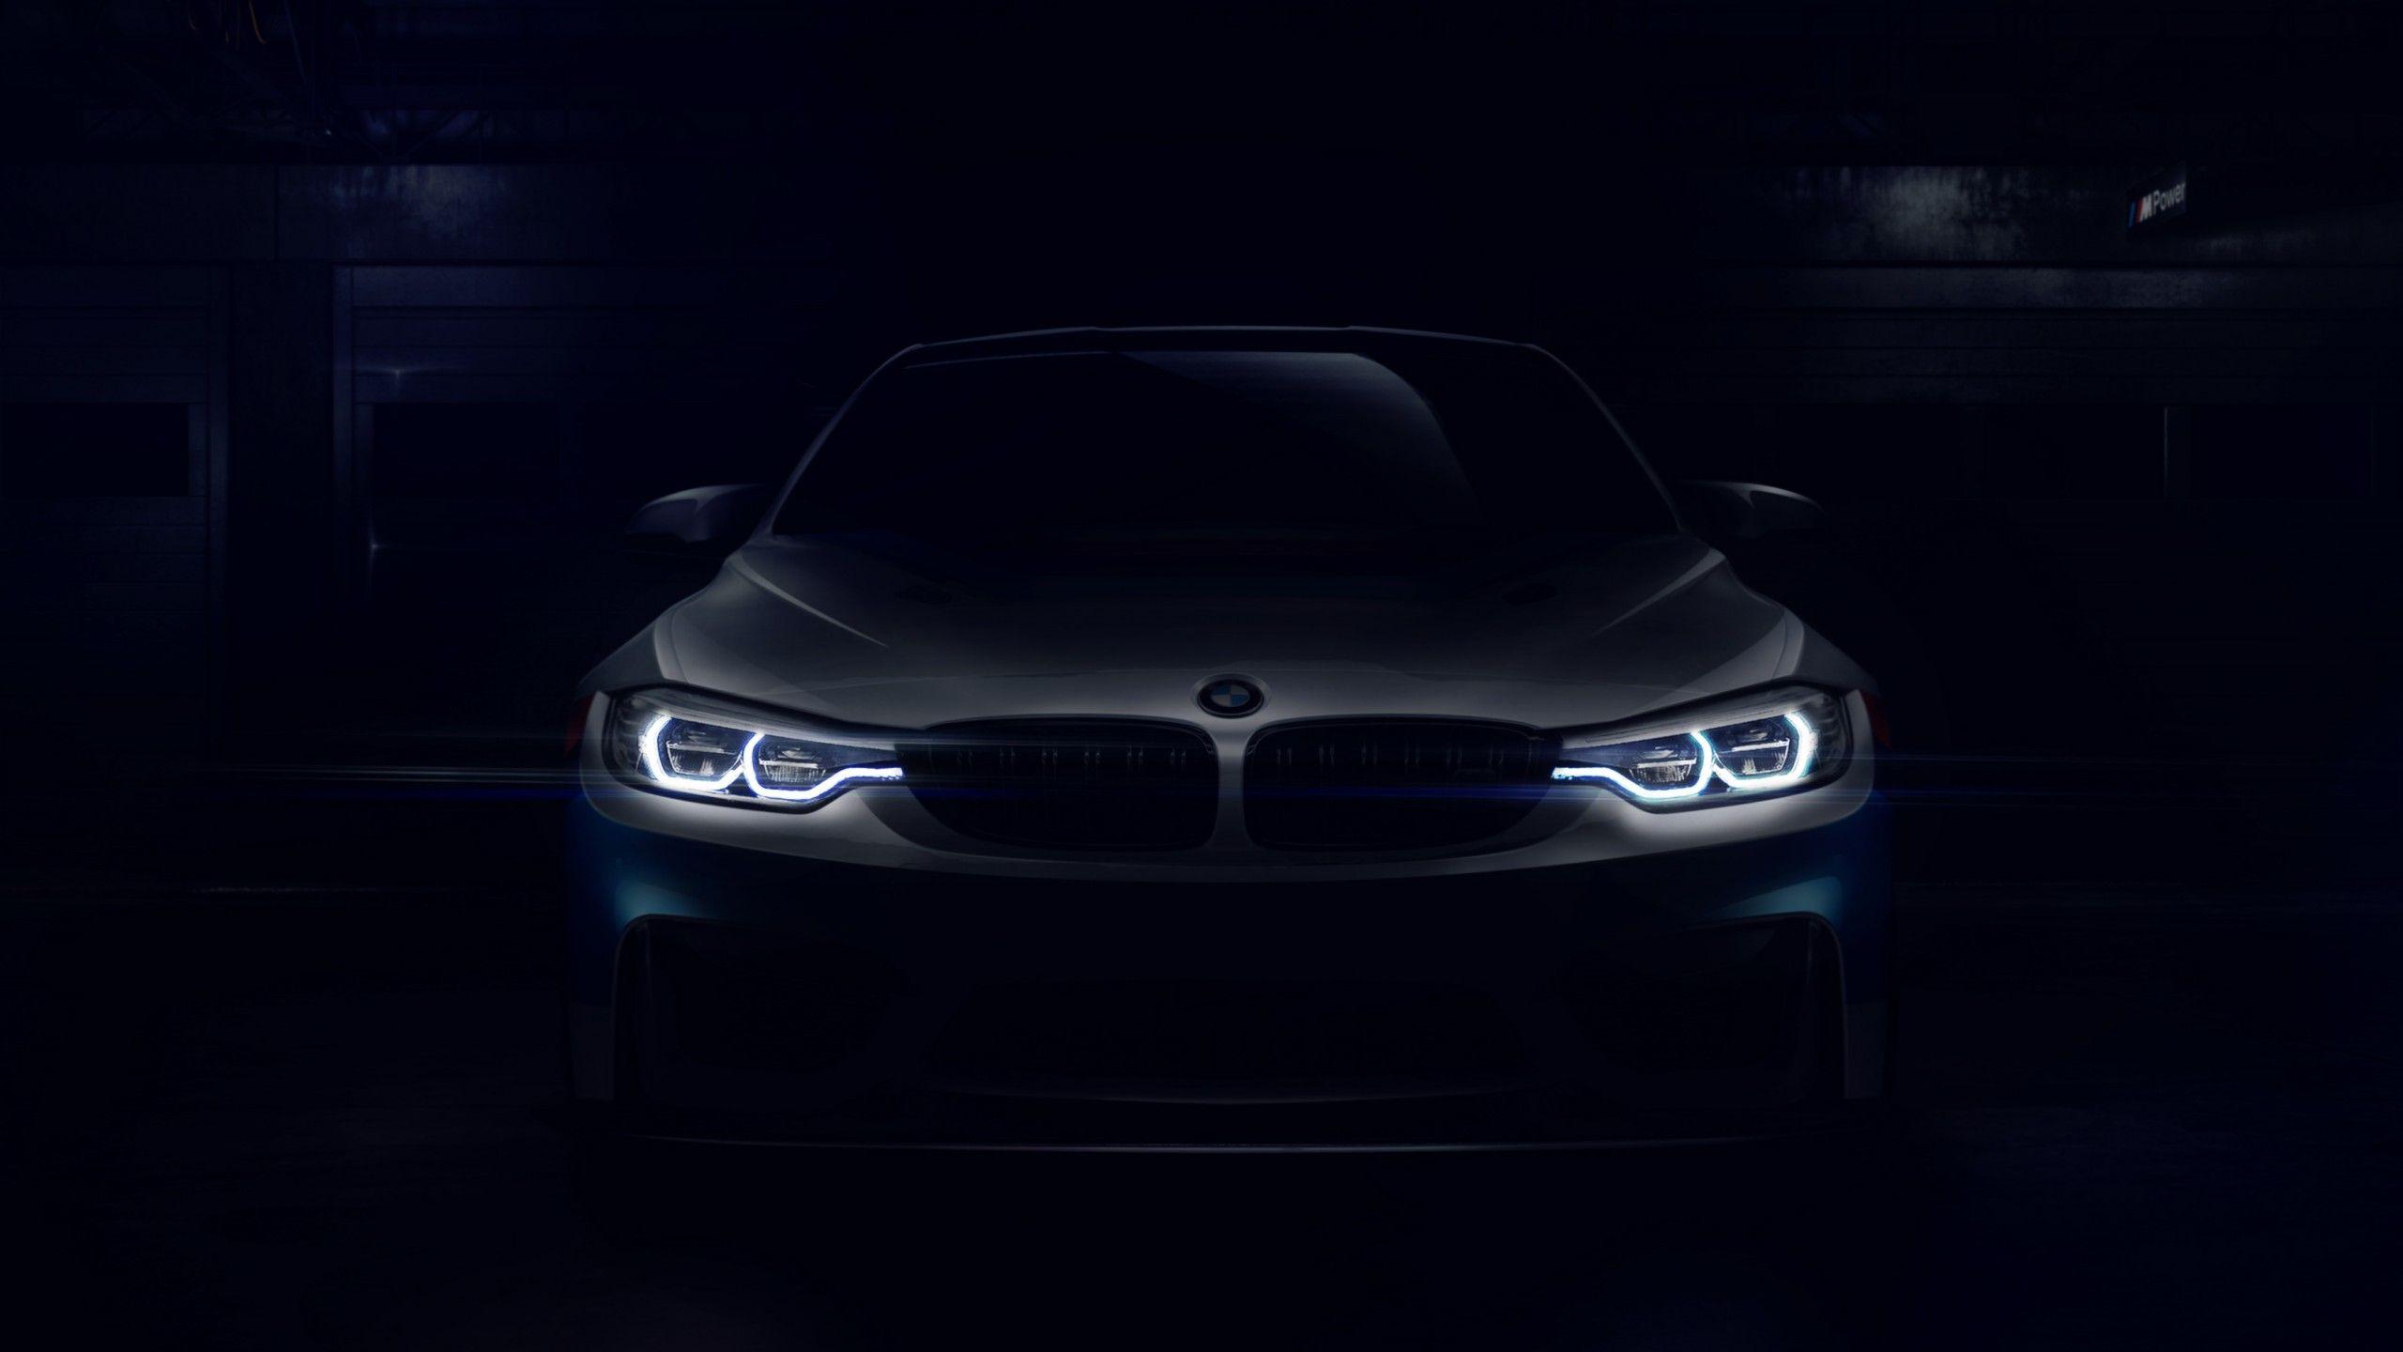
Thank You…

